Slide 1
Comparison of Madrid or Mexico City as host city for Spanish learners
Juan Paulo Vega
Applied Data Science Capstone
Final Report
February 2021

Slide 2
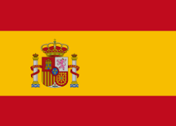
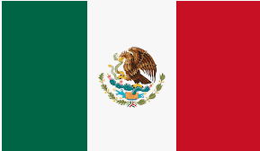
Introduction
People interested in learning other languages, for instance Spanish
Basically this experience could be had in Spain, or in a Latin American country. Usually Mexico City is considered (Mexico), but also Madrid (Spain).

Slide 3
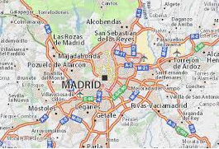
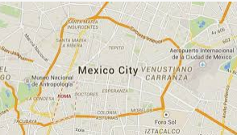
Objectives
To make a comparison between Madrid and Mexico City segmenting and clustering the neighborhoods of both cities, in order to be able to provide information regarding their characteristics and the services they offer.
The idea is to be able to find those particular neighborhoods that offer a mix of venues where they can study, work, have fun and learn more about the local culture and history.

Slide 4
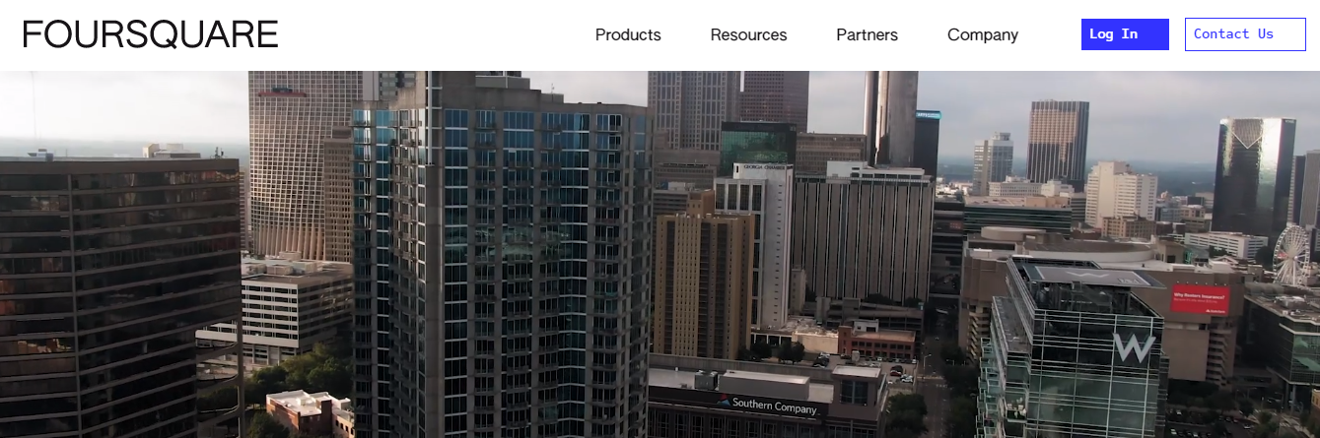
Data Sources
Boroughs and Neighborhoods of each city
Information about their postal code, latitude, longitude
Use of the Foursquare application to retrieve important information about venues
Clustering of the neighborhoods and fitting the k-means model to identify clusters
Additional information: important landmarks, country information, demographic indicators and quality of life index.

Slide 5
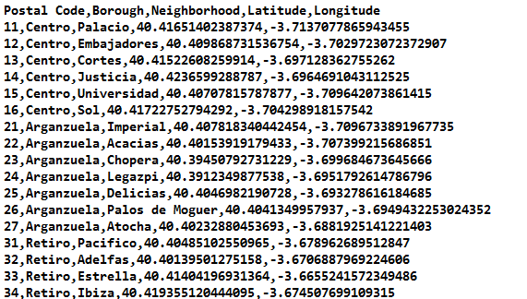
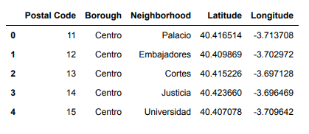
Methodology (Madrid case)
.CSV file with information about:
Postal Code
Borough
Neighborhod
Latitude
Longitude
Pandas Dataframe

Slide 6
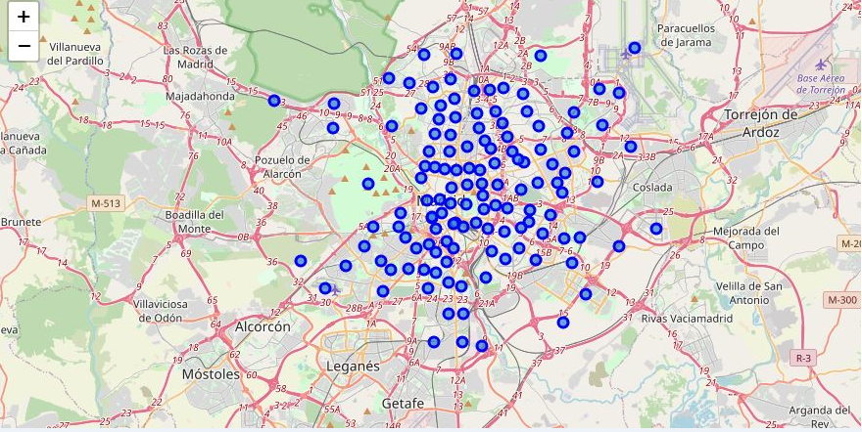
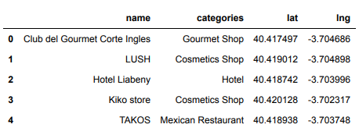
Map of Madrid with neighborhoods superimposed
Connection trough API with Foursquare service to retrieve venues (and their categories) for a particular neighborhood

Slide 7
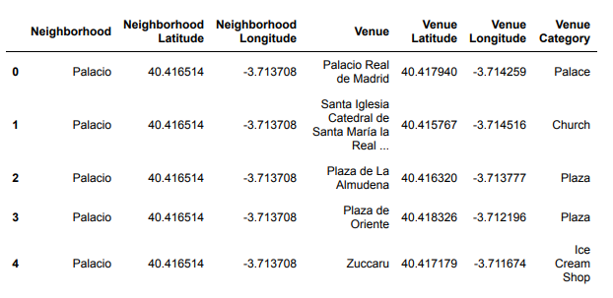
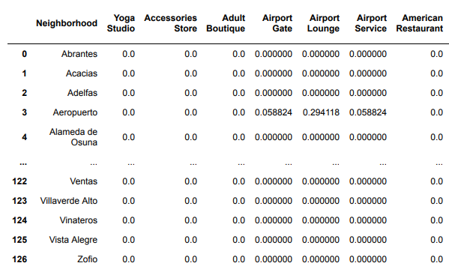
Exploration of Madrid neighborhoods: Pandas Dataframe 3439 rows:
Next: 277 unique categories

Slide 8
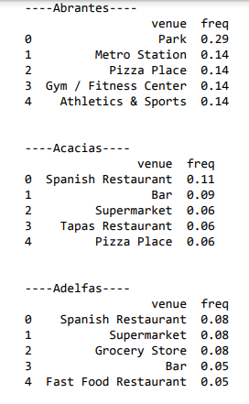
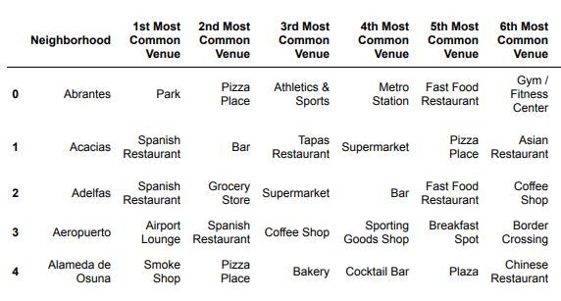
For each neighborhood venues with higher frequency
This information was also put into a Pandas Dataframe to sort the top 10 venues in descending order for each Neighborhood:

Slide 9
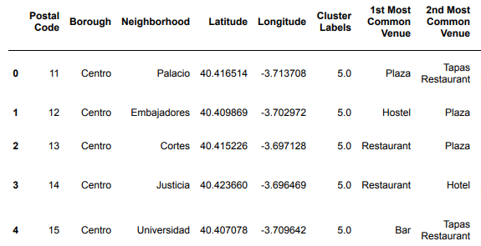
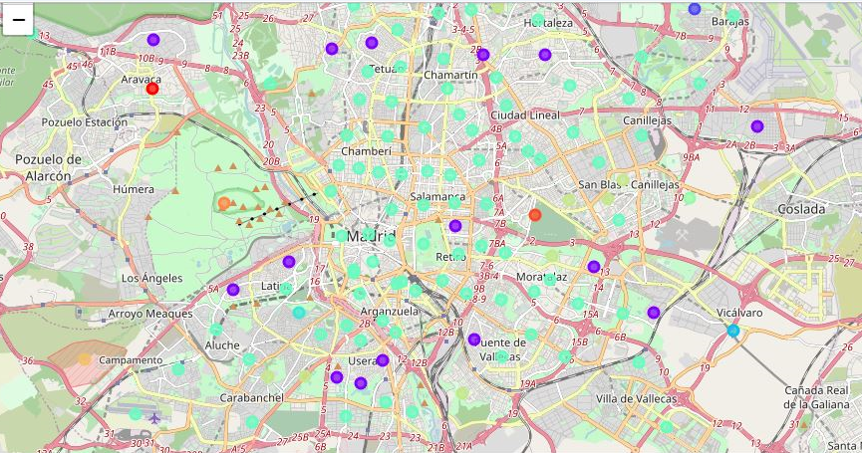
Fitting k-means model and assigning clusters to neighborhoods

Slide 10
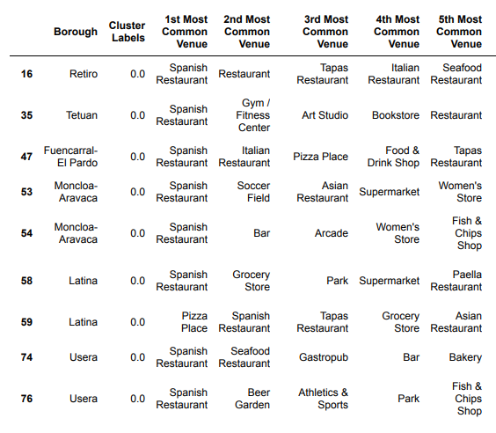
Example Cluster 0: “Spanish Restaurants”

Slide 11
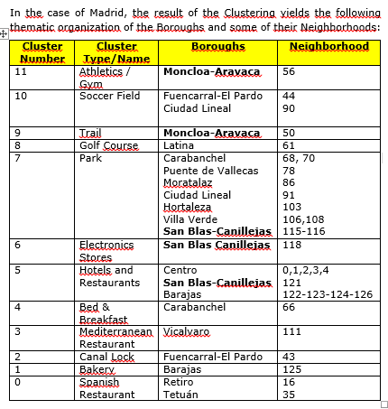

Slide 12
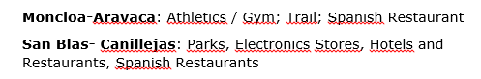
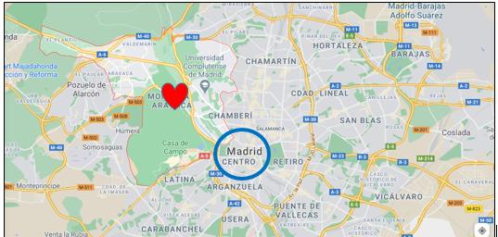
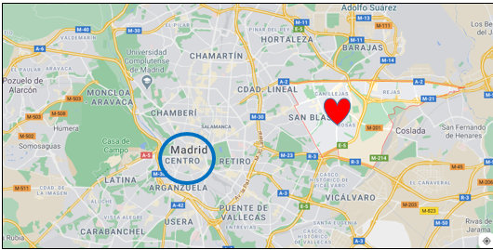

Slide 13
Moncloa-Aravaca
Hospital
Complutense University of Madrid
Polytechnic University of Madrid
The Museum of America
Madrid Amusement Park
Very close to the downtown area of Madrid.
San Blas-Canillejas
Parks
Airport
Additionally, Both Boroughs are equidistant from the new Chamartín Business District.
As a result of the previous analysis, Moncloa-Aravaca is suggested as the best candidate to live in Madrid for people who want to study Spanish. Besides, the Google Maps description for the Moncloa-Aravaca Borough is the following:
“The tree-lined Moncloa-Aravaca neighborhood is home to the large Casa de Campo park, where the Cable Car takes visitors a few steps from the Madrid Zoo Aquarium and the Amusement Park. Quiet terraced cafes line the Manzanares River and the Parque del Oeste promenade. In the afternoon, crowds enjoy sunset views from the Egyptian Temple of Debod. The students hang out in the bars near the Moncloa universities. "

Slide 14
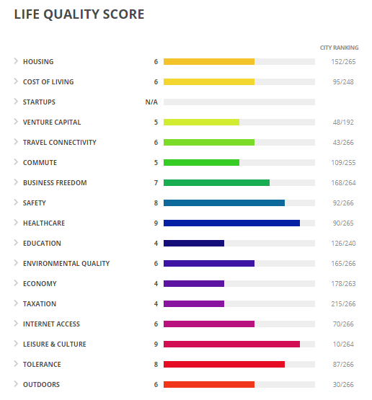
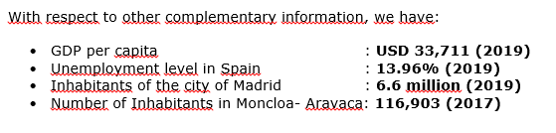
Madrid:
Moncloa-Aravaca

Slide 15
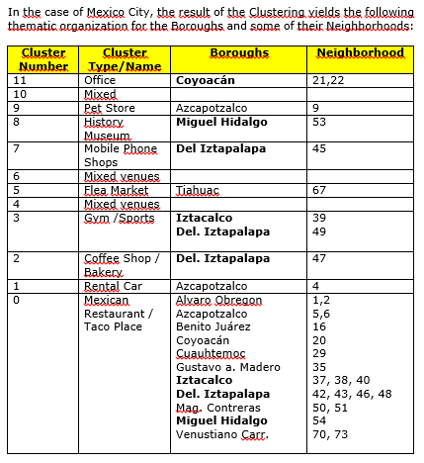

Slide 16
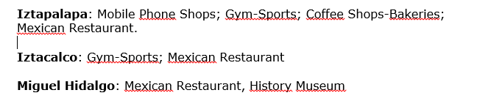
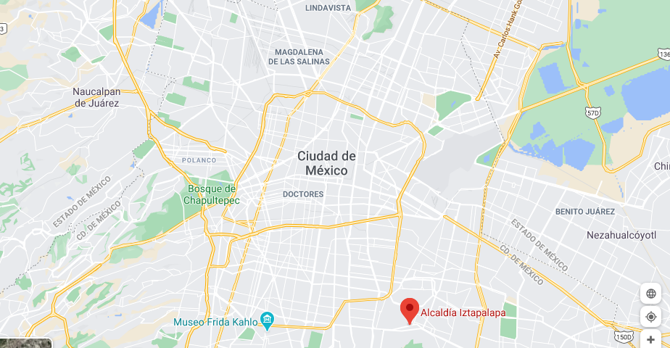
Iztapalapa
Far from the City Center

Slide 17
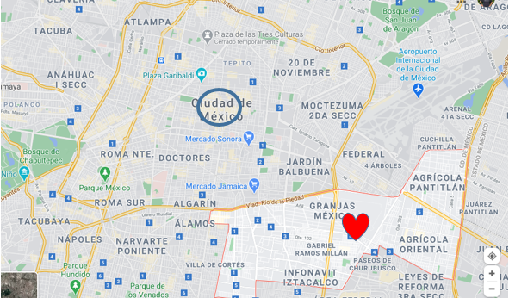
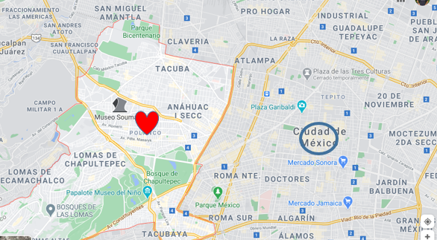
Iztacalco
Iztacalco
Food Market
Miguel Hidalgo
Anthropology National Museum
Park
Spanish Hospital
Military Center Hospital
Soumaya Museum
Hippodrome
Miguel Hidalgo
Both are closer to the City Center but MIGUEL HIDALGO has more diverse and interesting venues

Slide 18
As a result of the previous analysis, Miguel Hidalgo is proposed as the best candidate to live in Mexico City for people who want to study Spanish and learn about history, culture and also enjoy free time.
The description given by Google Maps of Miguel Hidalgo is as follows:
“Miguel Hidalgo mixes exclusive areas like Polanco, characterized by its sophisticated gastronomy and luxury brand stores, with simple residential districts like Escandon. The elegant Soumaya Museum houses works by great masters and sculptures by Rodin, while the National Museum of Anthropology displays artifacts from the Mayan period onwards. Within the extensive Bosque de Chapultepec park, the top of Castillo de Chapultepec (Chapultepec Castle) offers views of the entire city. "

Slide 19
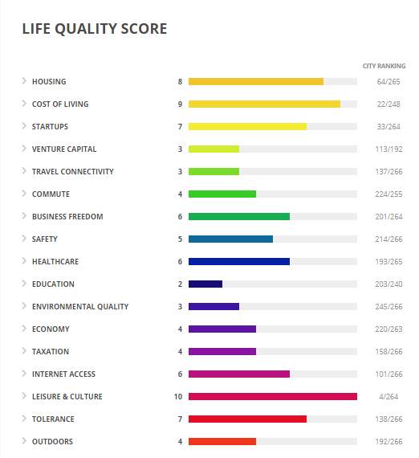
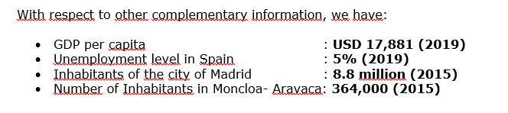
Mexico:
Miguel Hidalgo

Slide 20
Discussion
It is not easy to compare countries or cities. Rather, the analysis carried out shows the services and activities that a person could access in any of the two places indicated, but it really is difficult to say which is better.
Everything will depend on the personal taste. On the one hand, if someone prefers travelling to a developed country located in the old continent with a higher per capita income and with better Safety, Healthcare, Leisure & Culture and Tolerance scores, probably Madrid should be chosen (and the Moncloa-Aravaca Borough).
On the other hand, if someone would rather visit a country closer to the United States, a developing country, with a lower per capita income, then Mexico City and the Miguel Hidalgo Borough should be chosen.
Notwithstanding the above, it is clear that Madrid has more category wins according to the Life Quality Score.
If someone wants to consider other variables to compare both cities in other aspects, the website https://teleport.org/compare/madrid-and-mexico-city/ provides additional data to make a comparison. Here is the information for Madrid and Mexico City:

Slide 21
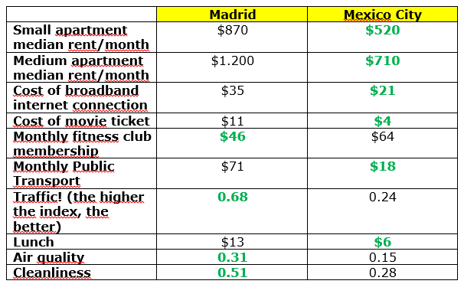
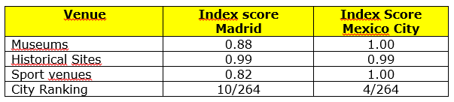

Slide 22
Conclusion
The objective of defining the best Boroughs to live, study and learn about the culture, as well as the language, was carried out for the capital cities of two Spanish-speaking countries: Madrid (Spain) and Mexico City (Mexico). It is not easy to compare countries, nor cities, however information was provided as to allow making the best choice considering personal preferences. Without a doubt, both countries and cities deliver unique experiences.
Most of the analysis was carried out thanks to Data Science and the use of Python, Jupyter notebooks and data frames, as well as clustering.
The use of different or more diverse or advanced tools might provide more insight into the the question that was analysed.

